Slide 1
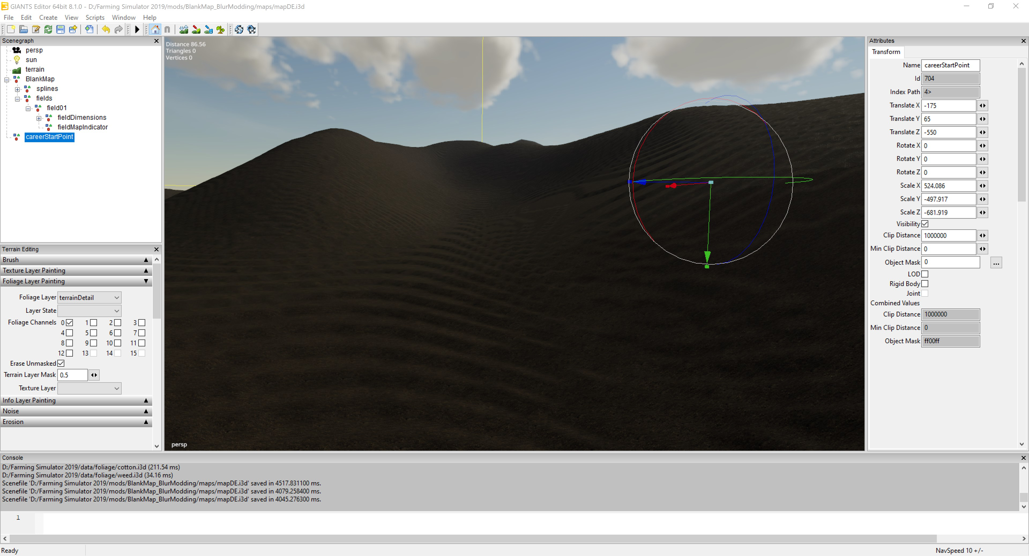
Precision Agriculture in Virtual Reality
Palouse virtual reality environment that simulates precision agriculture technologies

Slide 2

Precision Agriculture in Virtual Reality 2
Sponsor
Dev Shrestha
Team
Brad Whitesell
Chelsea Hogan
Joel Atwood

Slide 3
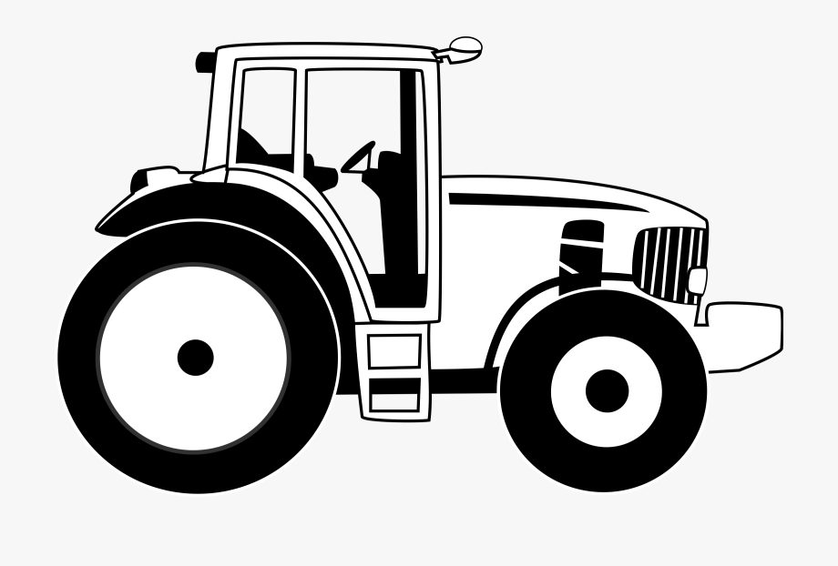
Project Objective
Create an immersive and realistic virtual reality experience that simulates the functionality of precision agriculture technologies.
Produce an engaging environment for teaching practical applications of precision agriculture technologies.

Slide 4
Value Proposition
Precision Agriculture is a modern crop management concept that utilizes emerging technologies to optimize return on investment, while reducing the cost in seed, fertilizer, fuel and time.
There is a need for an educational and promotional tool for showcasing and teaching practical applications of precision agriculture technologies.
To address this problem, we are developing an immersive and realistic virtual reality experience that simulates the functionality of these technologies.

Slide 5

Design Goals
Auto Pathing and GPS Navigation
Accurate Height Map Terrain
Pricing Options
Easy Setup Instructions

Slide 6
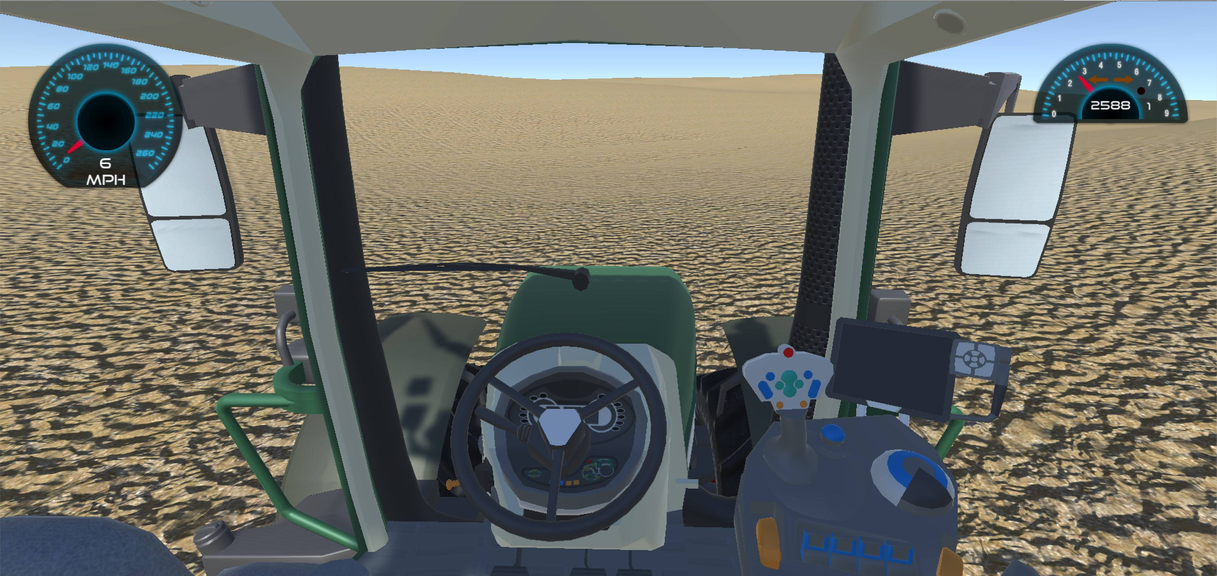
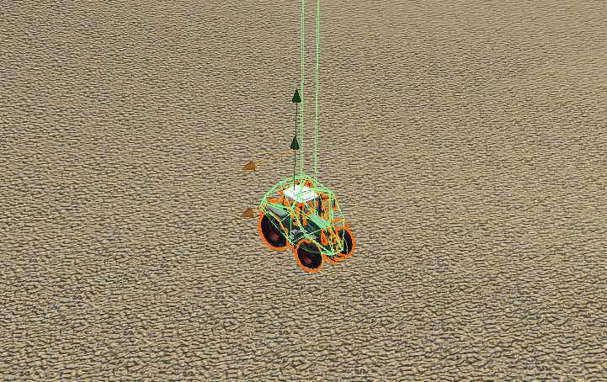
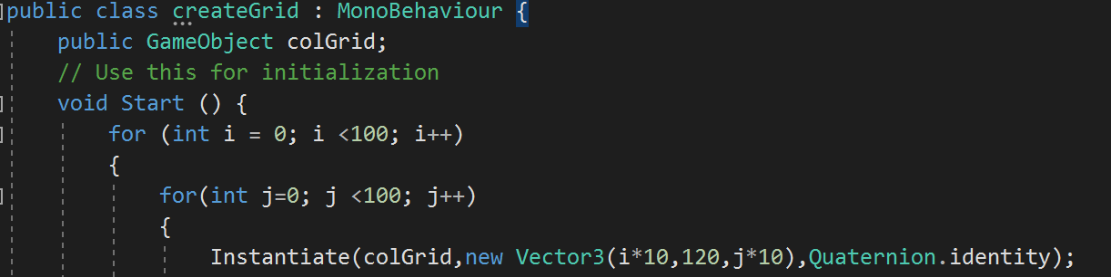
First Semester Development
Previously Implemented Features
Realistic tractor control
Realistic terrain
Fertilization tracking and visualization
Developing Features
Tractor console navigation
Field boundaries
Crop yield tracking and visualization

Slide 7
Second Semester Development
Implemented Features
Cook Farm Farming Simulator Mod
Accurate Height Map Terrain
Auto Pathing Navigation

Slide 8
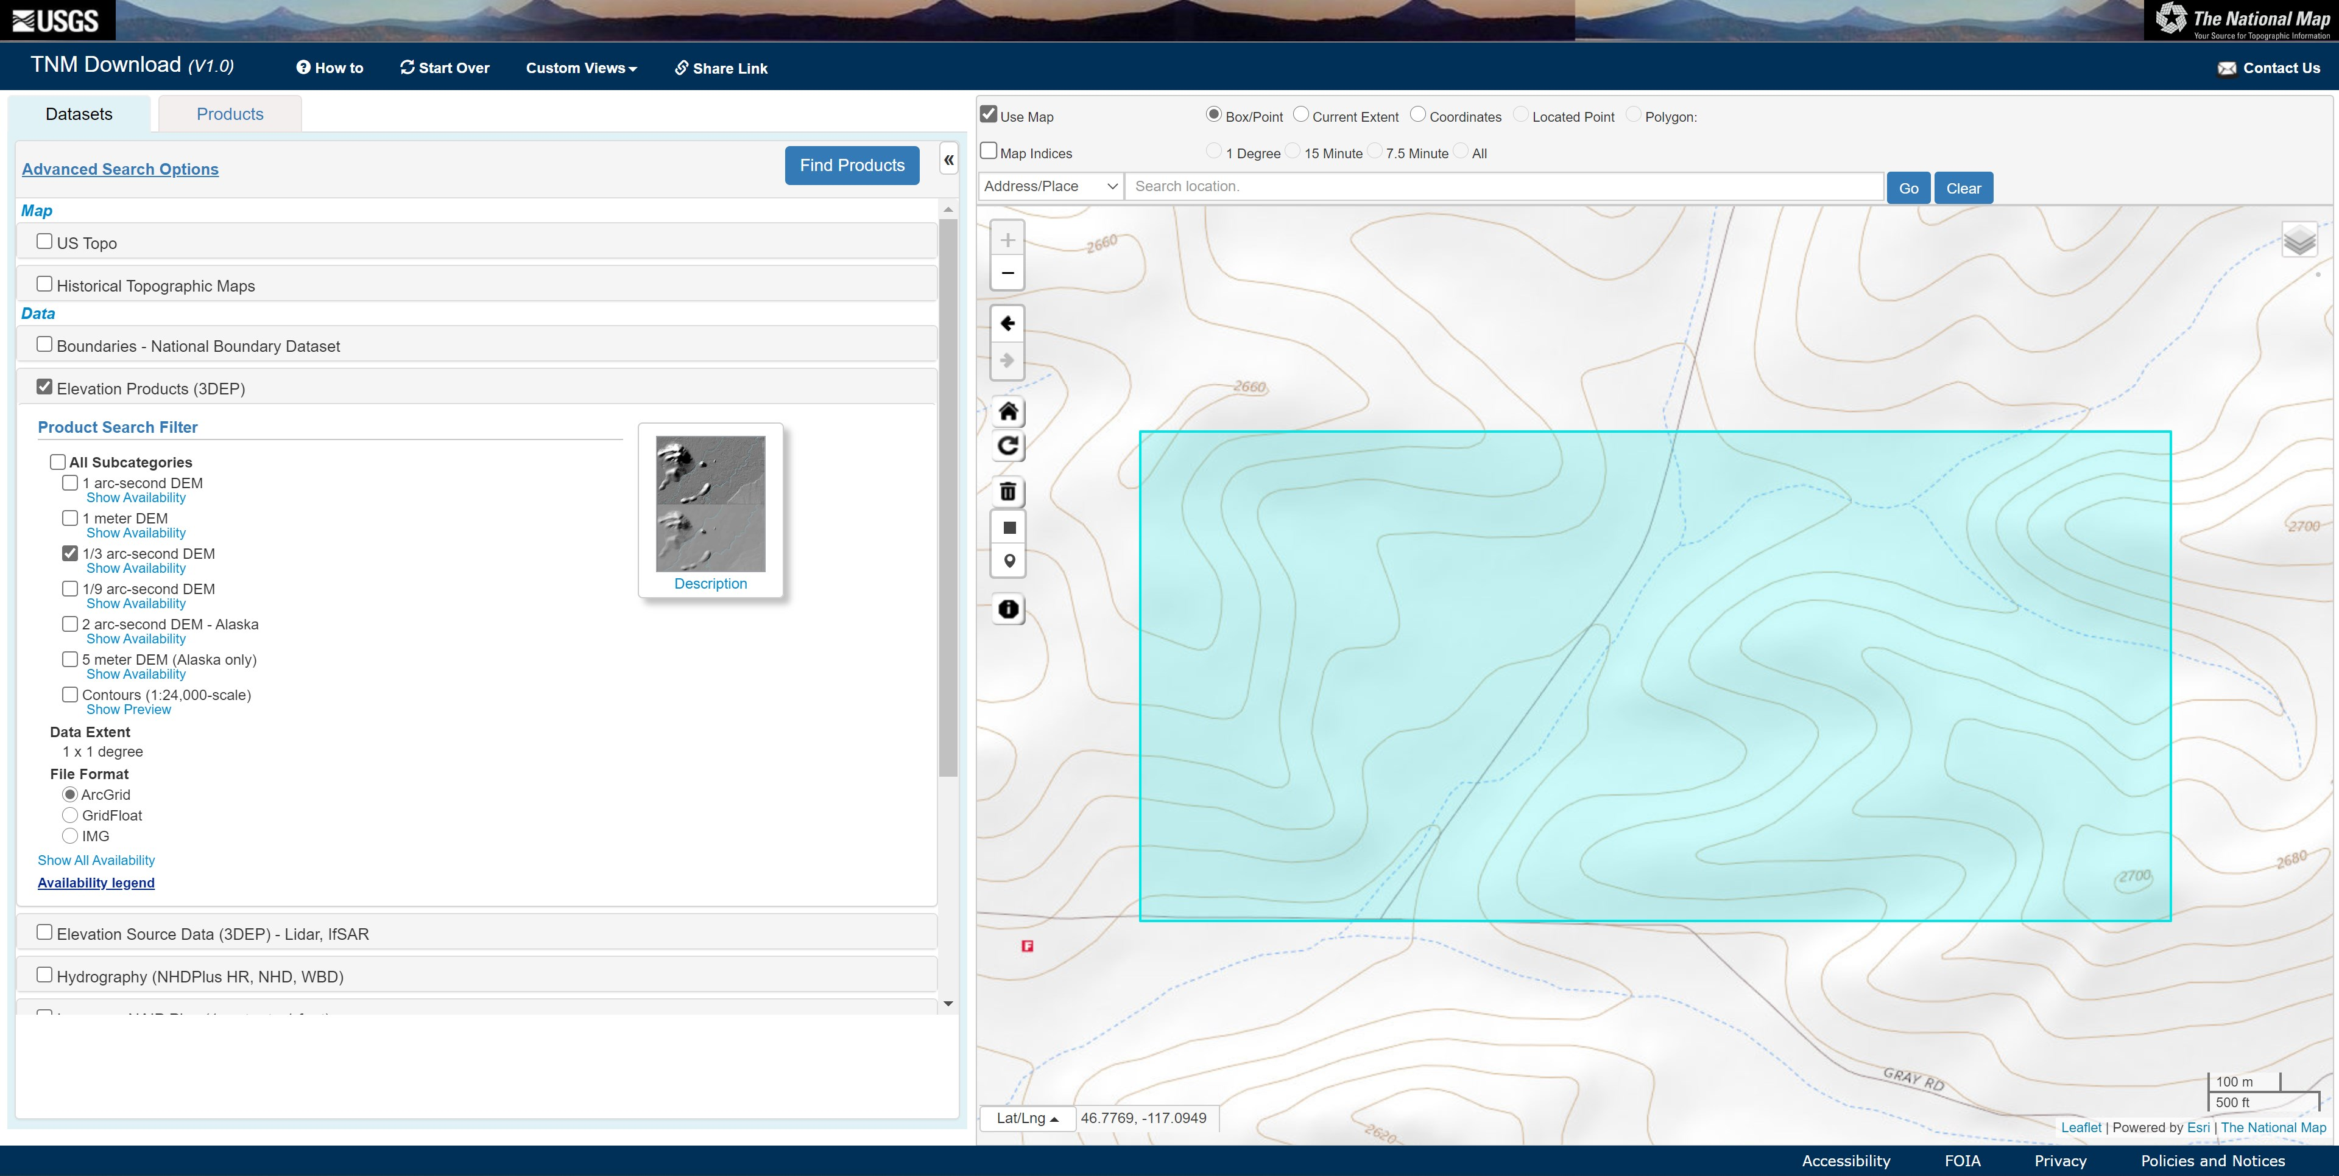
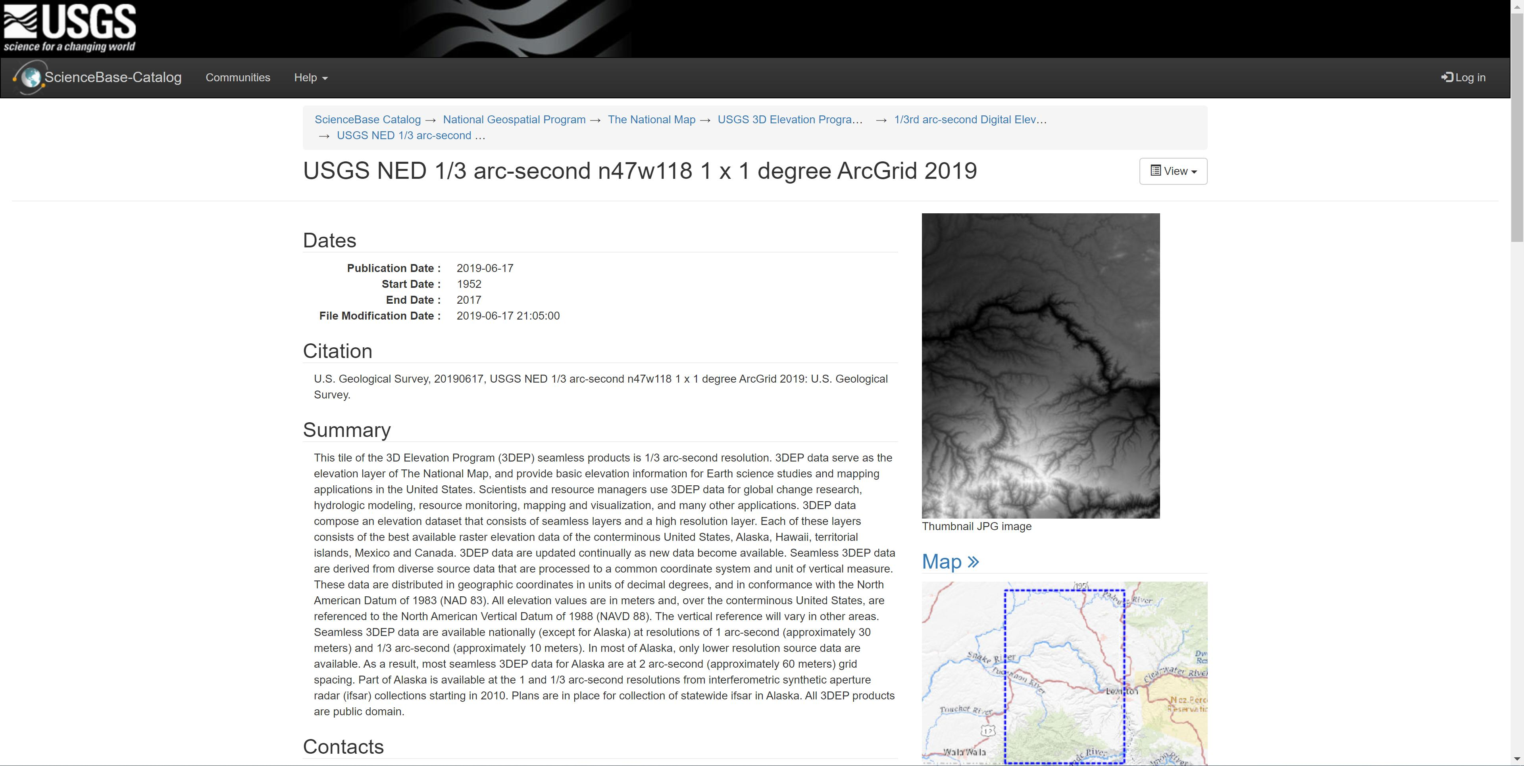
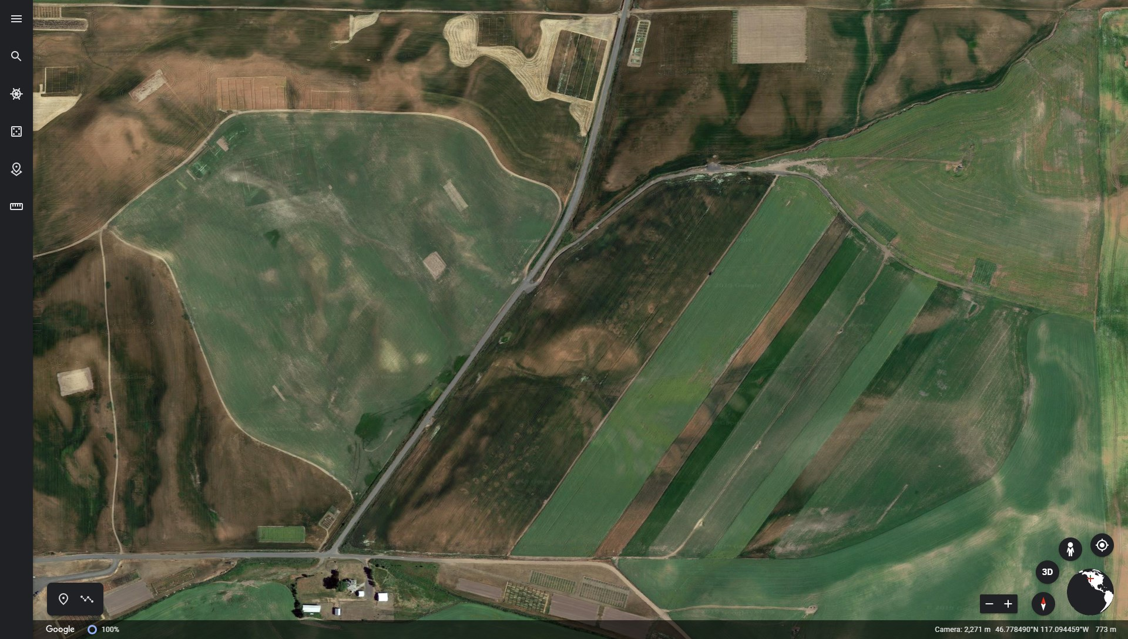
Second Semester Development – Data

Slide 9
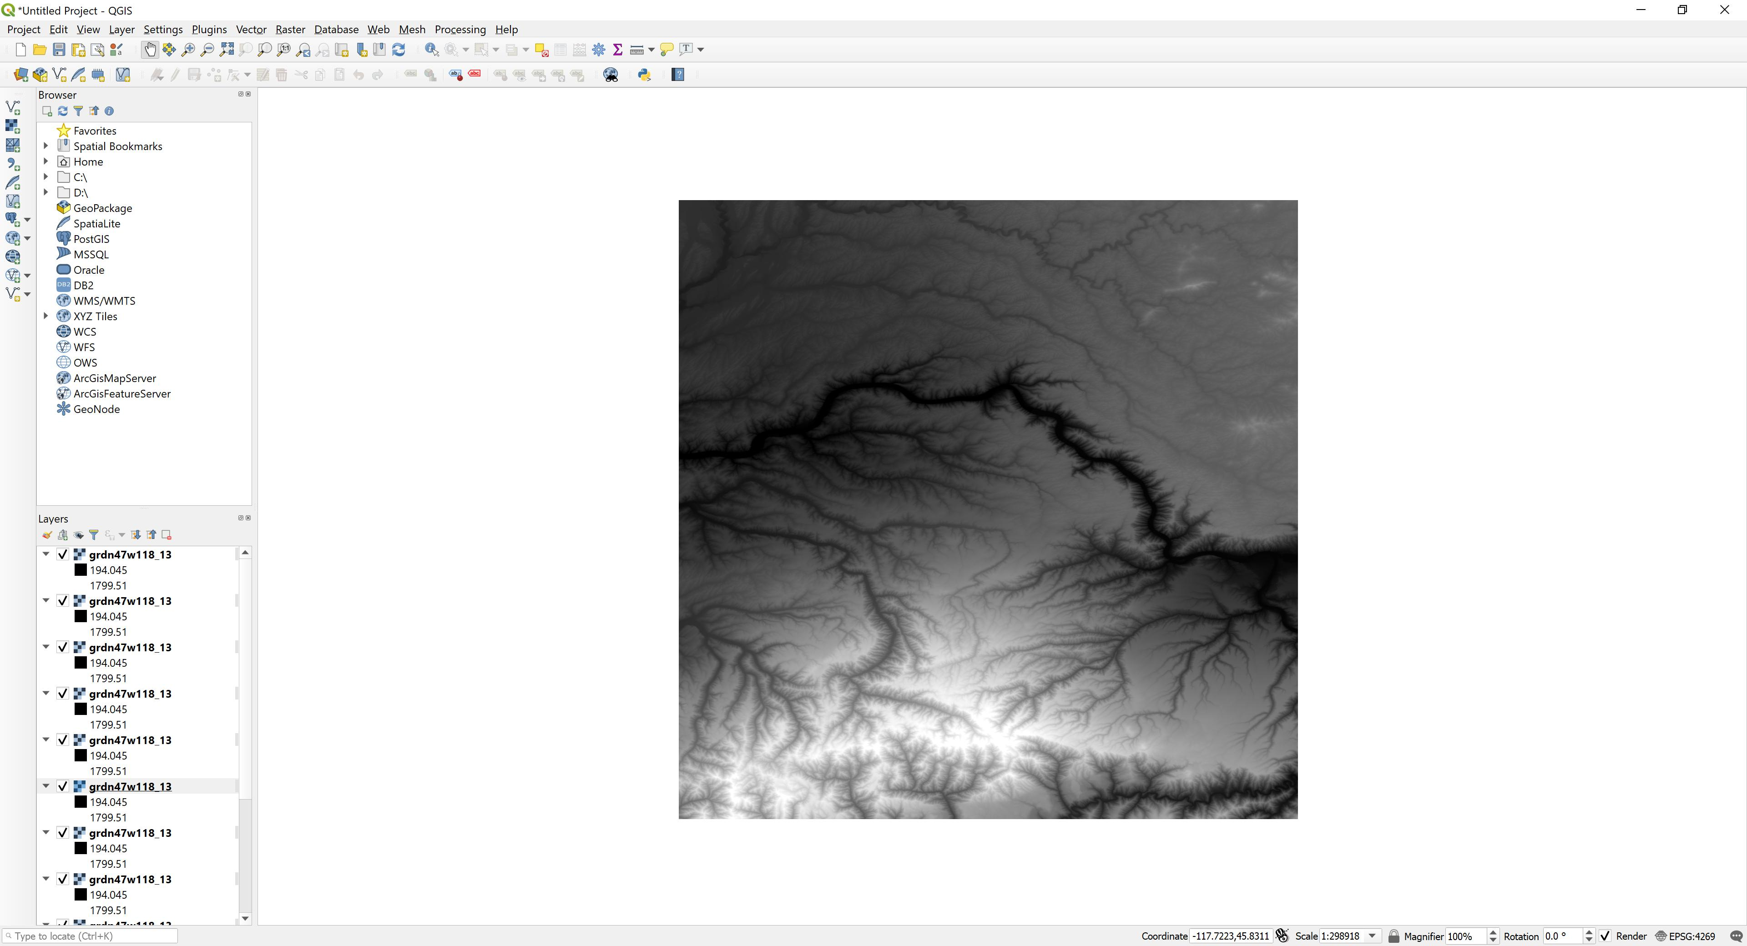
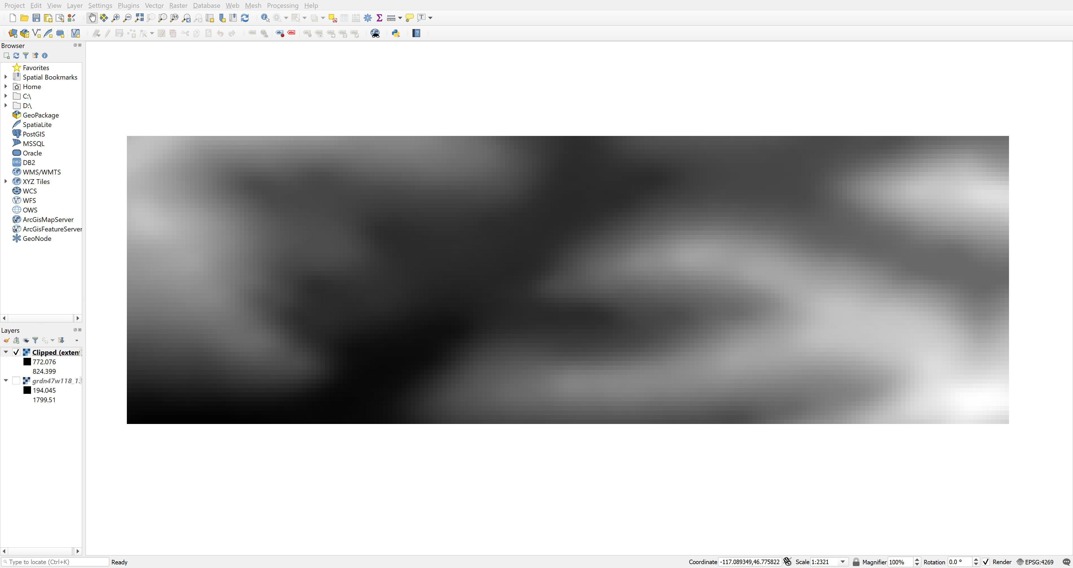

Second Semester Development – Data Manipulation

Slide 10

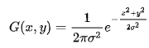
Second Semester Development – Data Smoothing
Unmodified DEM
DEM with σ = 10 Gaussian Smoothing

Slide 11
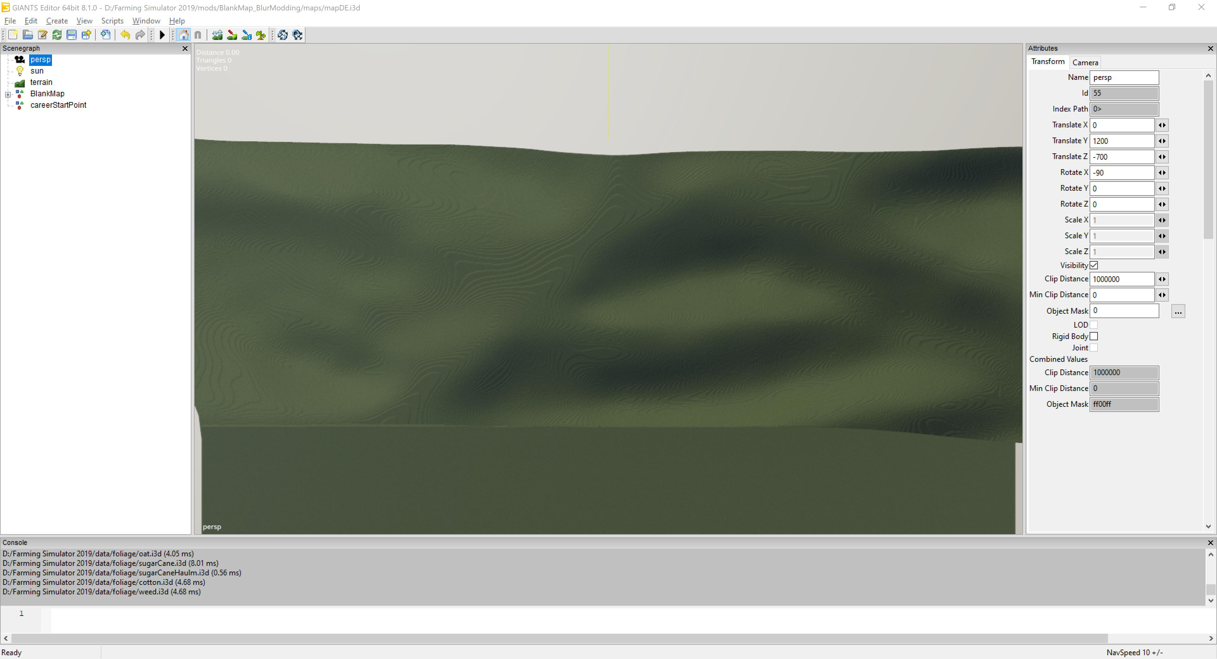
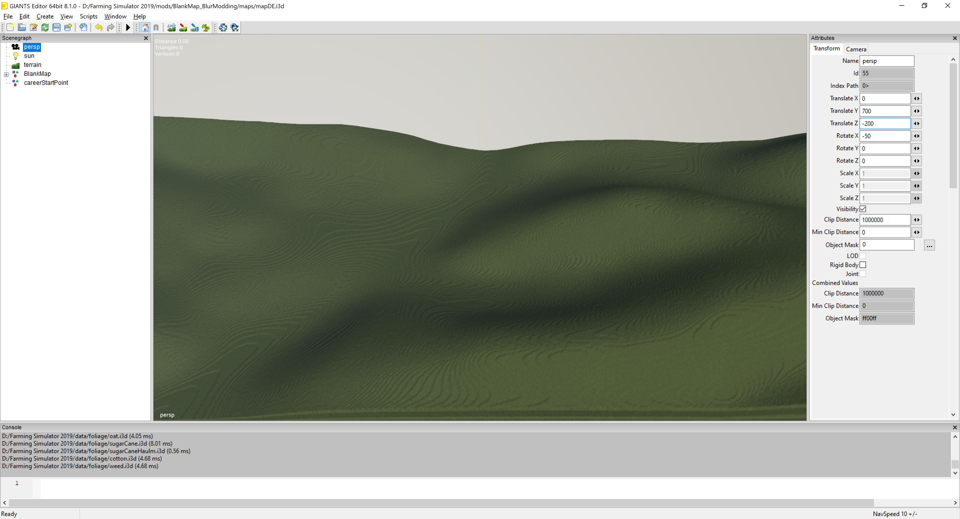
Second Semester Development – Scene

Slide 12
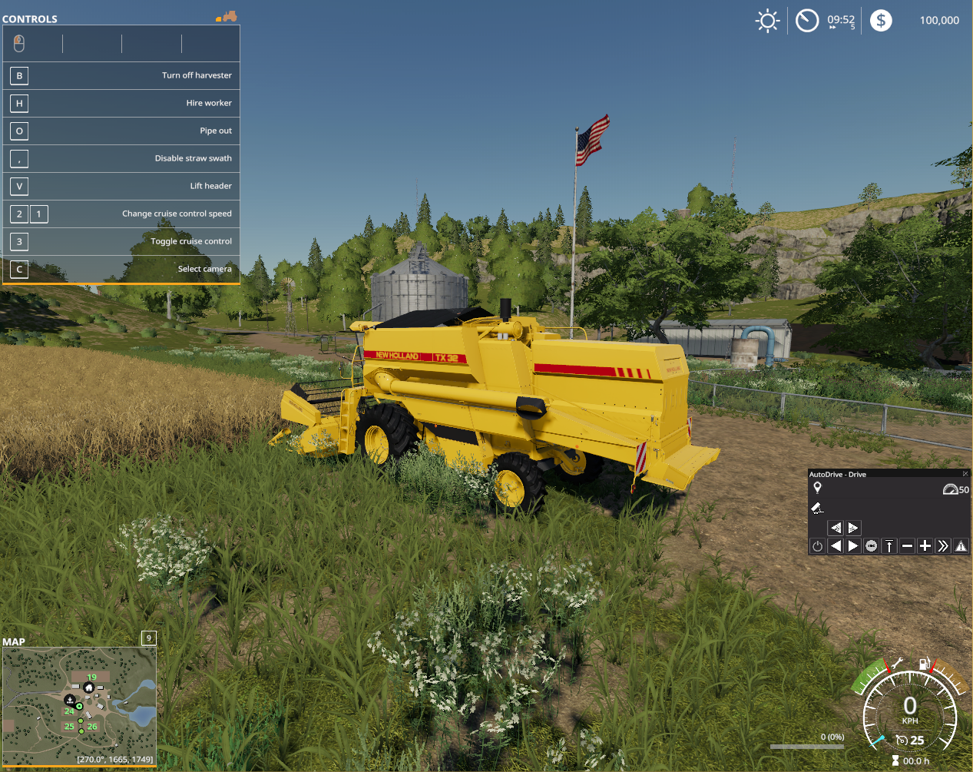
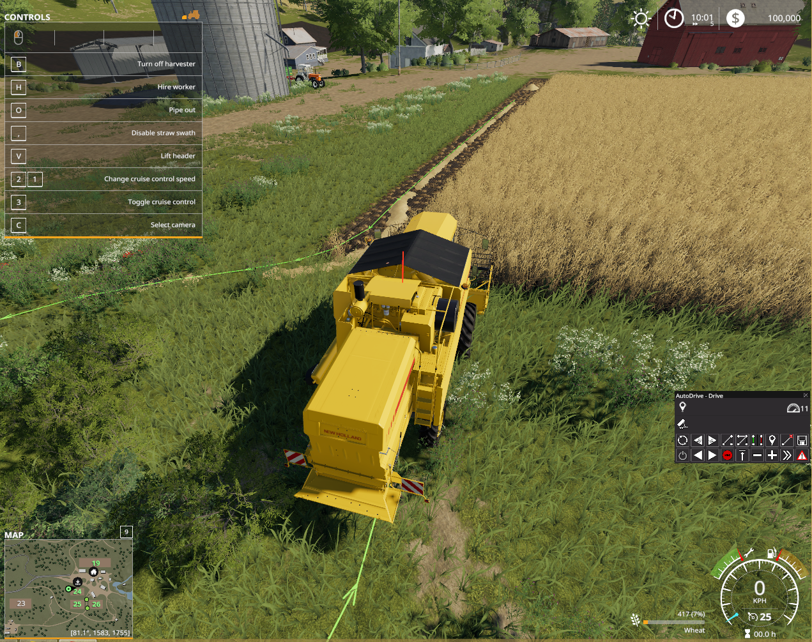
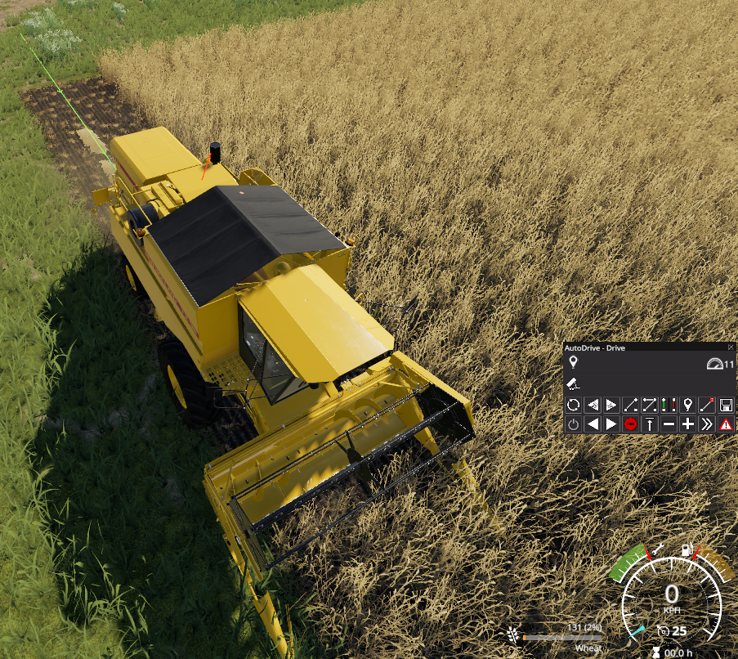
Second Semester Development – Auto Pathing

Slide 13
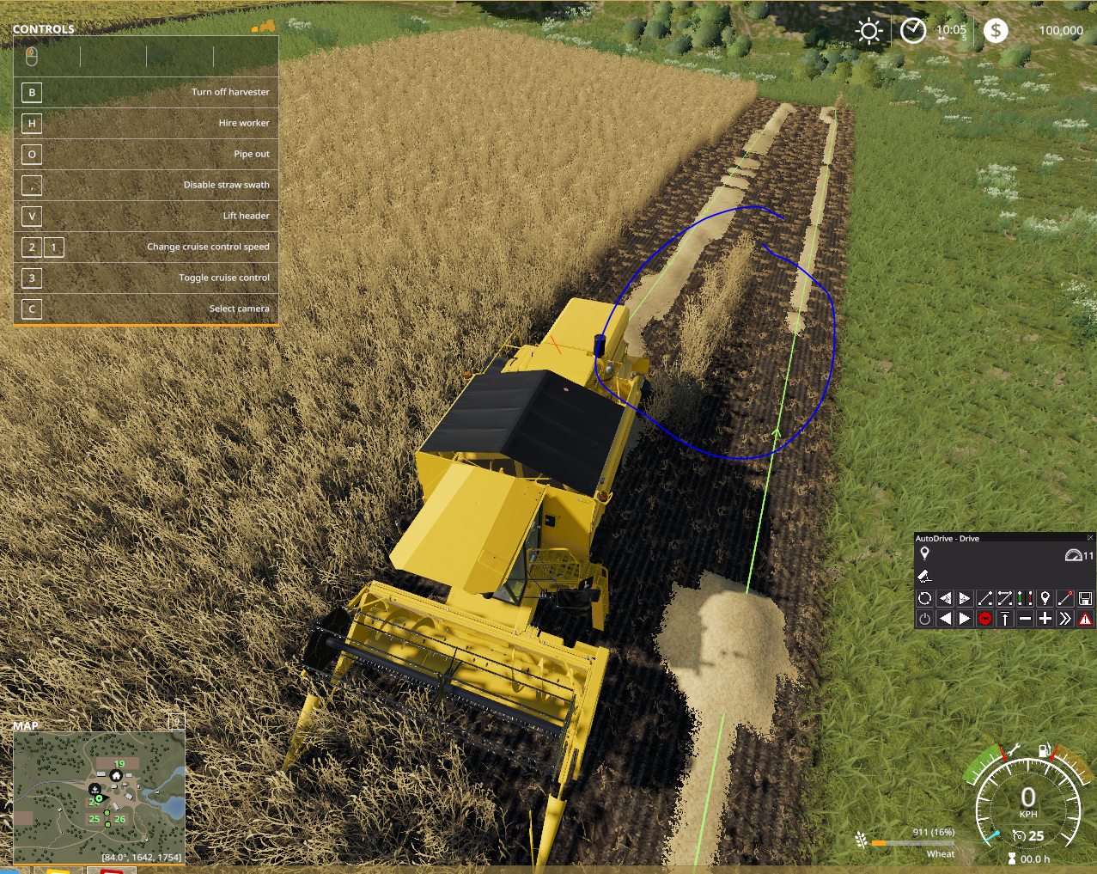
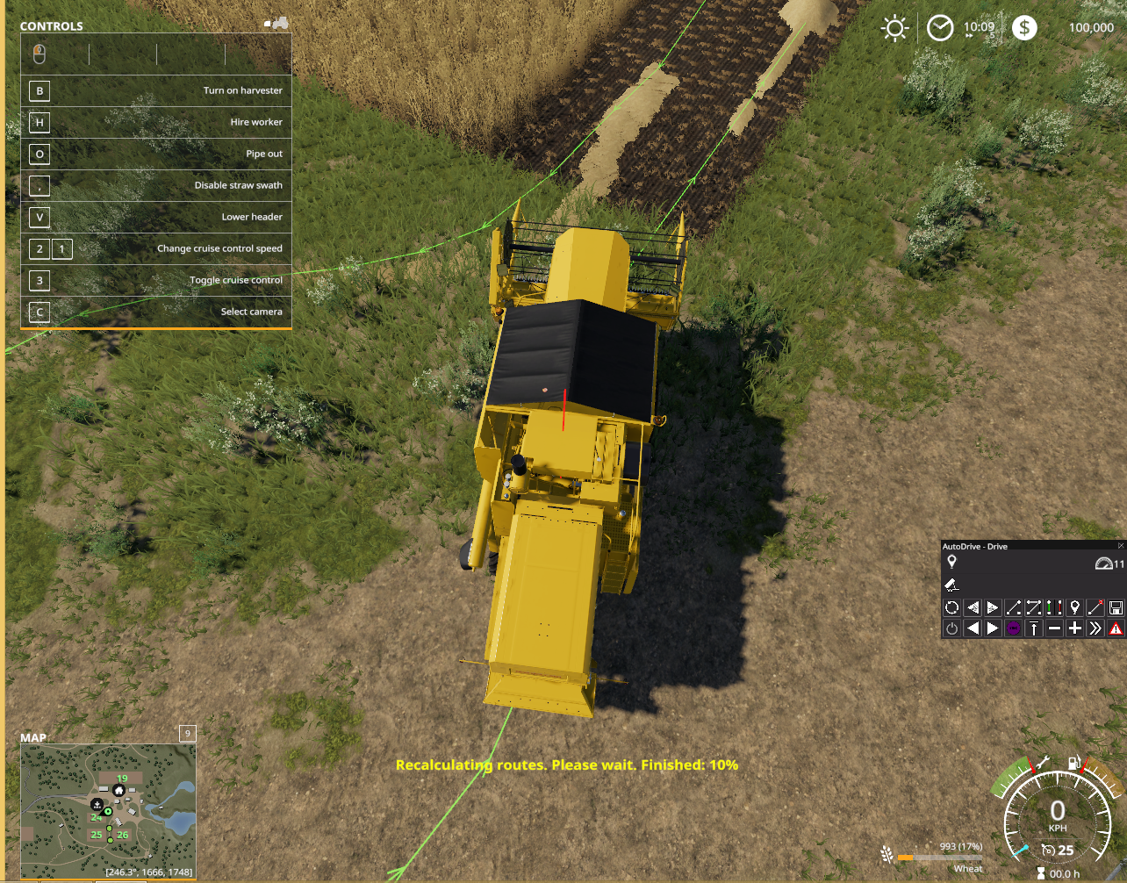
Second Semester Development – Auto Pathing

Slide 14
Future Development
More accurate terrain data
More immersive environment with field boundaries
Tooling for adding more fields
Training scenarios
Tractor waypoints
Planned path vs. Manual path vs. Optimized path
Stat reports
Time to finish job
Amount of climbing
Overlap and skipped sections
Speed variations

